Slide 1
EGA: Explainable Deep Belief Network based Autoencoder using novel Extended Garson Algorithm
9th International Conference on Data Management, Analytics & Innovation
Satyam Kumar^{1,2}, Vadlamani Ravi¹ ¹Institute for Development and Research in Banking Technology (IDRBT), Hyderabad.
²IIT Bombay
18 January, 2025

Slide 2
Contents
Introduction
Literature review
Proposed Methodology
Datasets
Results
Conclusion and Future Work
References

Slide 3
Introduction
Deep Belief Network (DBN) are generative, probabilistic models that use multiple layers of latent variables to capture hierarchical representations of input data.
Layers: DBNs consist of multiple layers of Restricted Boltzmann Machines (RBMs).
Training: Layers are trained greedily one at a time, which helps in initializing weights for deep neural networks.
Introduction

Slide 4
Literature Review
1991
1998-2004
2017
2022
Garson Algorithm
Extension of Garson to 2 layered MLP
Decomposition of Neural outputs
Path weights interpretation for shallow network
Garson was the first to propose an algorithm that estimates the feature contribution levels to the target feature in 1 hidden layer neural network.
Sun et al. proposed an improved Garson algorithm for sensitivity analysis and demonstrated accuracy.
Gevrey et al. compared methods like partial derivatives and sensitivity analysis for ecological datasets.
Olden et al. compared methodologies on synthetic datasets.
Shrikumar et al. introduced Deep Learning Important FeaTures (DeepLIFT), decomposing neural network outputs by backpropagating neuron contributions.
Santos et al. proposed path weights for interpreting feature importance in shallow network for fMRI data.
Literature Review

Slide 5
Motivation
Understanding Model Decisions: Helps users understand how and why a DBN makes specific decisions.
Feature Importance: Understanding which features are most influential can lead to better feature engineering.
Motivation

Slide 6
Proposed Methodology (1 of 2)
Introduced a framework (EGA) that extends the Garson algorithm to DBNs based on autoencoders (DBNA), allowing us to assess feature importance across multiple hidden layers.
Research addresses two critical questions in this regard:
Effect of Additional Features: Adding extra features impacts feature importance across different datasets.
Effect of Hidden Layers: Increasing the number of hidden layers affects feature importance.
Proposed Methodology

Slide 7
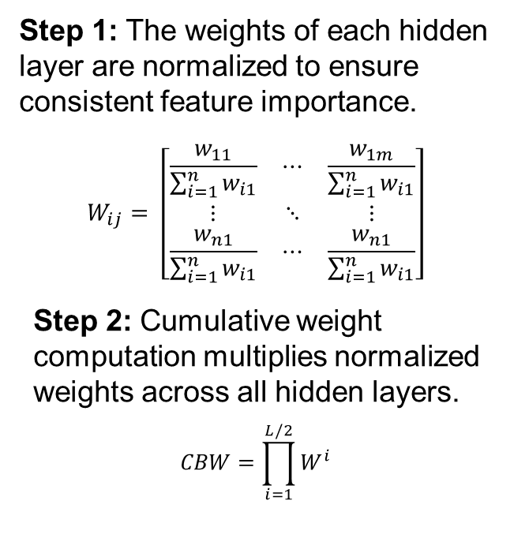
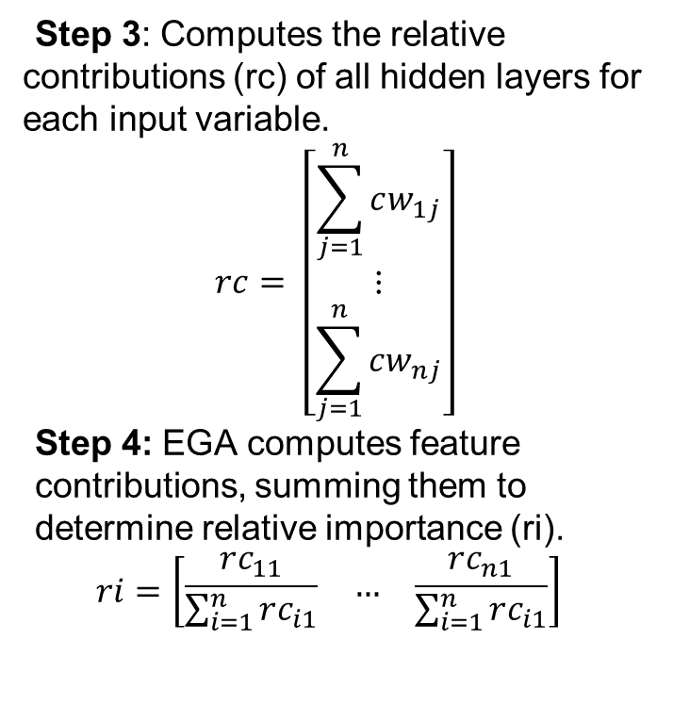
Proposed Methodology (2 of 2)
Step 1: The weights of each hidden layer are normalized to ensure consistent feature importance.
$$W_{ij}= \left[\begin{matrix}\frac{w_{11}}{\sum_{i=1}^{n}{w_{i1}}} & ⋯ & \frac{w_{1m}}{\sum_{i=1}^{n}{w_{i1}}} \\ ⋮ & ⋱ & ⋮ \\ \frac{w_{n1}}{\sum_{i=1}^{n}{w_{i1}}} & ⋯ & \frac{w_{n1}}{\sum_{i=1}^{n}{w_{i1}}}\end{matrix}\right]$$
Step 2: Cumulative weight computation multiplies normalized weights across all hidden layers.
$$CBW=\prod_{i=1}^{L/2}{W^{i}}$$
Step 3: Computes the relative
contributions (rc) of all hidden layers for each input variable.
$$rc= \left[\begin{matrix}\sum_{j=1}^{n}{cw_{1j}} \\ ⋮ \\ \sum_{j=1}^{n}{cw_{nj}}\end{matrix}\right]$$
Step 4: EGA computes feature contributions, summing them to determine relative importance (ri).
$$ri=\left[\begin{matrix}\frac{rc_{11}}{\sum_{i=1}^{n}{rc_{i1}}} & … & \frac{rc_{n1}}{\sum_{i=1}^{n}{rc_{i1}}}\end{matrix}\right]$$
Proposed Methodology

Slide 8
Experiments
DBNA was trained with 2 configuration of hidden layers:
2 and 4 hidden layers.
RBM₁ RBM₂ RBM_{L-1} RBM_{L} RBM_{L/2}
Statistical significance of EGA and Wald χ² was tested using paired t-test with 18 degrees of freedom at 5% significance level.
BottleNeck Layer
Input
W₁
HL₁
W₂
HL₂
W_{l/2}
W₂^{T}
HL_{L-1}
W₁^{T}
HL_{L}
Experiment

Slide 9
Reason for proposed methodology
Efficient feature extraction: By focusing on bottleneck layer, EGA can produce different features.
Preservation of Auto-association: Transpose of cumulative bottleneck matrix (CBW) and premultiplying it by CBW preserves auto-association.

Slide 10
Datasets
Task | Datasets | Statistics
Classification | Loan Default (LD) | 30000 instances with 24 features. 23364 are non-defaulters, 6636 are defaulters
 | Credit card Churn Prediction (CCP) | 14814 instances with 21 features 13812 are loyal customers and 1002 are churners
 | Auto Insurance fraud (AIF) | 24000 instances with 24 features 94% are non-fraudulent and 6% are fraudulent
 | Credit card Fraud detection (CCF) | 284807 instances with 30 features 492 fraudulent transactions
 | Financial News Sentiment (FN) | 8004 sentences 3 sentiments- Positive, Neutral, Negative
Regression | Boston Housing (BH) | 506 instances, 14 features
 | Body fat (BF) | 252 instances,13 features
 | Automobile miles per gallon (Ampg) | 492 instances, 5 features
 | Forest fires (FF) | 517 instances, 13 features
 | Air Pollution (Pol) | 9358 instances, 8 features
Datasets

Slide 11
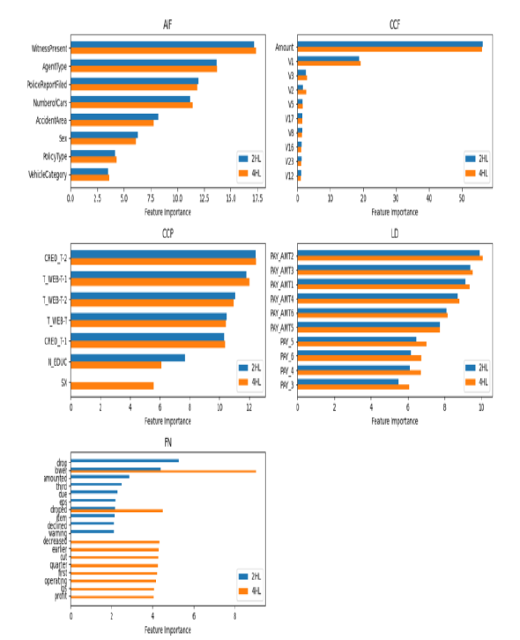
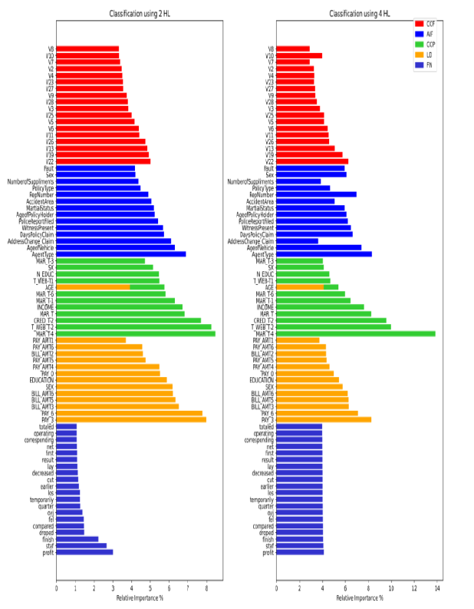
Results- Classification Datasets
Results

Slide 12
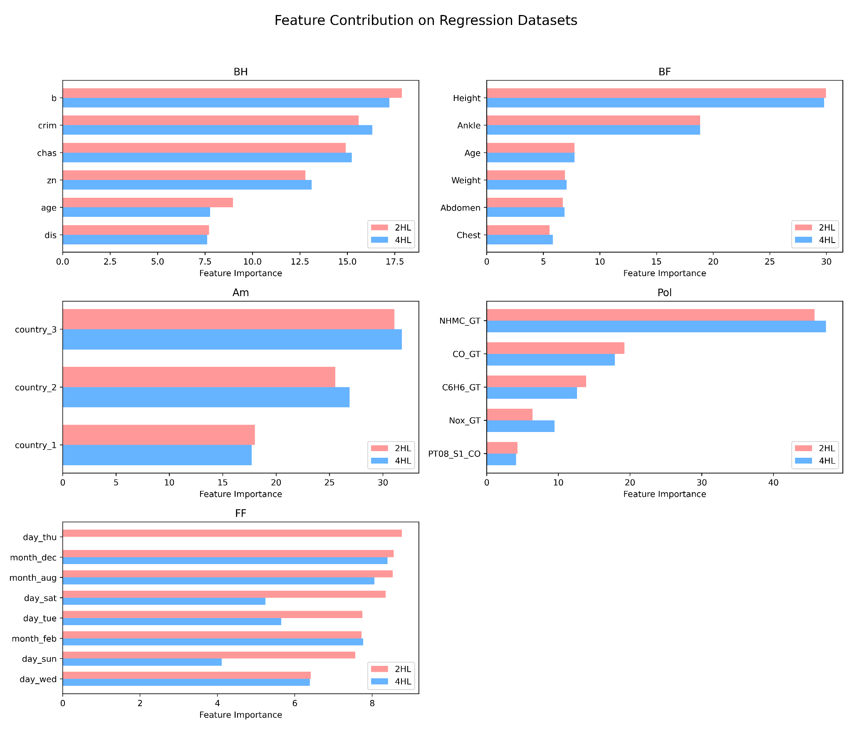
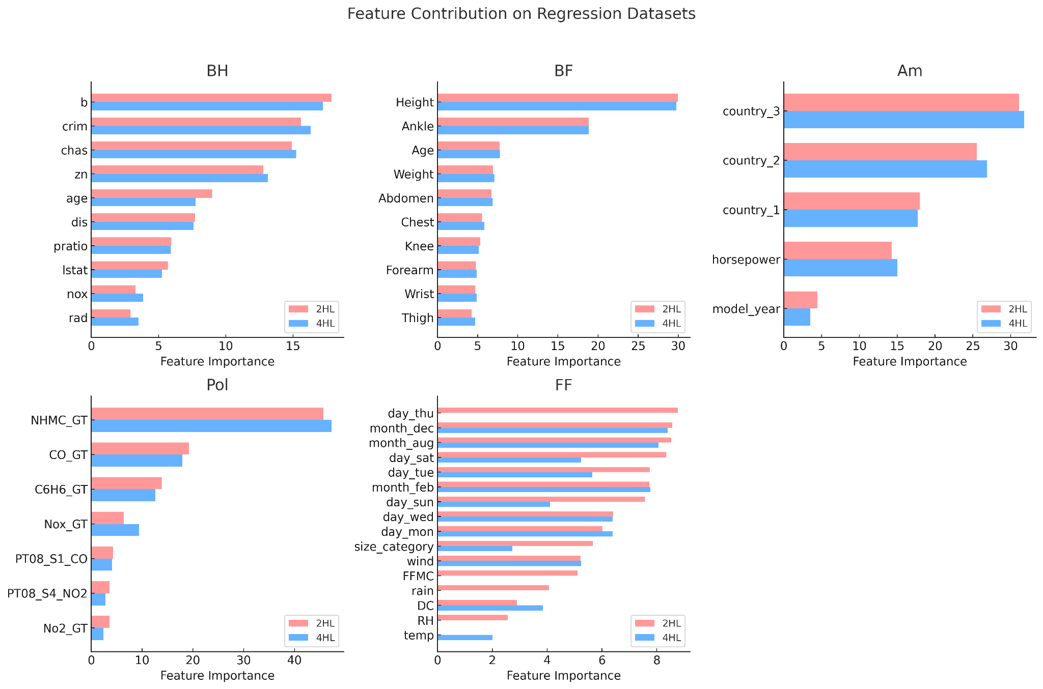
Results- Regression Datasets
Results

Slide 13
Conclusion and Future Work
EGA is proposed to explain DBNA through feature contribution. EGA is scalable to any hidden layers.
Increasing hidden layers and adding more features have shown enhanced feature importance. Statistical validation and careful consideration of both will be essential to understand the true feature contribution.
Future Work: Comparison with other feature importance methods such as Local Interpretable Model agnostic (LIME) and SHapley Additive exPlanations (SHAP).
Conclusion and Future Work

Slide 14
References
G. D. Garson, “Interpreting neural-network connection weights,” AI Expert, vol. 6, no. 4, pp. 46–51, Apr. 1991.
A. H. Sung, “Ranking importance of input parameters of neural networks,” Expert Syst Appl, vol. 15, no. 3, pp. 405–411, 1998.
J. D. Olden, M. K. Joy, and R. G. Death, “An accurate comparison of methods for quantifying variable importance in artificial neural networks using simulated data,” Ecol Modell, vol. 178, pp. 389–397, 2004.
M. Gevrey, I. Dimopoulos, and S. Lek, “Review and comparison of methods to study the contribution of variables in artificial neural network models,” Ecol Modell, vol. 160, no. 3, pp. 249–264, 2003.
J. dos Santos and dos Santos, Path Weights Analyses in a Shallow Neural Network to Reach Explainable Artificial Intelligence (XAI) of fMRI Data. In International Conference on Machine Learning, Optimization, and Data Science, 2022
A. Shrikumar, P. Greenside, and A. Kundaje, “Learning important features through propagating activation differences,” in Proceedings of the 34th International Conference on Machine Learning - Volume 70, in ICML’17. JMLR.org, 2017, pp. 3145–3153.

Slide 15
Thank for your attention
Email – learnsatyam@gmail.com; vravi@idrbt.ac.in
Questions?

Slide 16
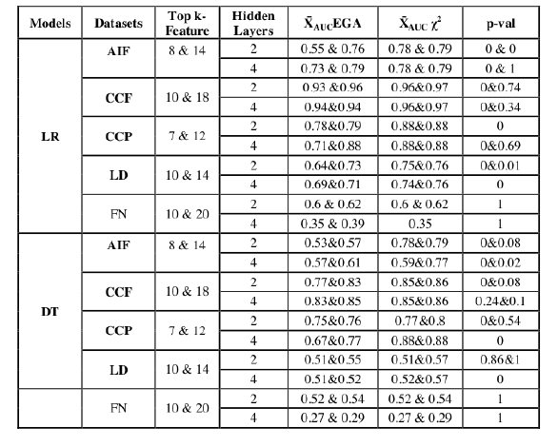
T-test results – Classification datasets
Results

Slide 17
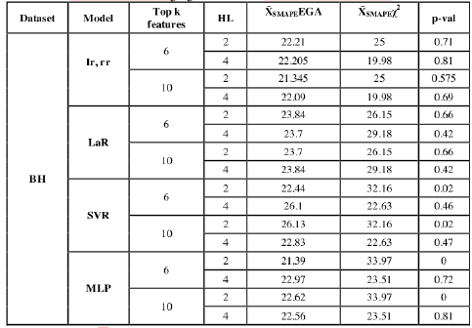
T-test results – Regression datasets

